Slide 1


SCHOOL OF ARTS AND SCIENCE, AVIT CAMPUS VINAYAKA MISSION’S RESEARCH FOUNDATION DEPARTMENT OF COMPUTER SCIENCE AND APPLICATIONS
CLOUD MANUFACTURING ARCHITECTURE BASED ON PUBLIC BLOCKCHAIN TECHNOLOGY
Guided by
FACULTY NAME :
Mr. S.SENTHILKUMAR
MCA.,M.Phil.,
Presented by
NAME : SATHISHKUMAR BS
REG NO : 4151610075
DEPT : INT(BCA-MCA)
V-YEAR, X-SEM

Slide 2
CONTENT
ABSTRACT
INTRODUCTION
EXISTING SYSTEM
PROPOSED SYSTEM
SYSTEM REQURIEMENTS
SYSTEM ARCHITECTURE
DATAFLOW DIAGRAM
DATABASE DESIGN
USECASE DIAGRAM
CLASS DIAGRAM
ACTIVITY DIAGRAM
MODULES & MODULES DESCRIPTION
SCREENSHOTS
CONCLUSION
FUTURE ENHANCEMENT

Slide 3
ABSTRACT
With Industry 4.0, IT infrastructure has started to be used more effectively in the manufacturing sector. Cyber physical systems, IoT, cloud manufacturing, big data are some of the technologies that make up the concept of Industry 4.0.
These technologies have solved many problems in the manufacturing sector. One of these technologies, cloud manufacturing technology, has emerged with the idea of pay as you go.
This technology has enabled manufacturing resources to be leased and shared on a global scale.
However, it has problems arising from its central structure and the need for a reliable 3rd party. Reliability, security, continuity, scalability, data lock-in, single point failure, data manipulation are some of the main problems.
Blockchain (BC) is a decentralized and distributed technology. The data stored on the BC network cannot be altered in any way.
With these features, we believe that BC-supported cloud manufacturing systems can overcome the aforementioned problems and eliminates the need for a reliable 3rd party.

Slide 4
INTRODUCTON
TECHNOLOGICAL developments in manufacturing systems have changed the competitive factors in the sector.
Before 1970s, cost, which is one of these factors, one the most important factor, whereas quality gained importance after the 70s.
By 1990s, service and environmental factors gained importance and in the 21st century, information became the most important factor.
The information is the foundation of the 4th industrial revolution, namely, Industry 4.0.
The term Industry 4.0 collectively refers to a wide range of current concepts, including cyber-physical systems (CPS), internet of things (IoT), simulation, cloud computing, big data and advanced analysis techniques, service-oriented technologies, virtualisation and so on.

Slide 5
EXISTING SYSTEM
All operations are stored in the same SC.
It is difficult to update.
Since a single SC address will be generated, the use of the same address may cause security problems.
It is very difficult to maintain in the long-term.
The person deploying the SC may have access to the SC.
Re-deploying SC for each new business will increase the cost.
In this study, it can be said that it would be more appropriate to store it in a database since manipulation of the list of sources addresses will not cause a serious security problem.

Slide 6
PROPOSED SYSTEM
With cloud manufacturing, businesses can meet their needs without any investment by using a centralized and remotely accessible system. To take advantage of CM, users can use cloud manufacturing software interfaces.
The service providers identify and market their advantaged resources and competitive capabilities in the cloud platform.
Inherently provides several important technological advantages such as durability, invariance, process integrity and transparency to users that are implications of its structural architecture.
In this study, Ethereum network is used to take the advantages of public BC network and SCs. The Ethereum network is the second largest BC network after the Bit coin network.

Slide 7
SYSTEM REQUIREMENTS
Hardware Requirements:
System : Pentium IV 2.4 GHz.
Hard Disk : 40 GB.
Floppy Drive : 1.44 Mb.
Monitor : 15 VGA Colour.
Mouse : Logitech.
RAM : 256 Mb.
Software Requirements:
Operating system : Windows 7.
Front End : JAVA
Database : MSQL
Tools : Eclipse Oxygen

Slide 8
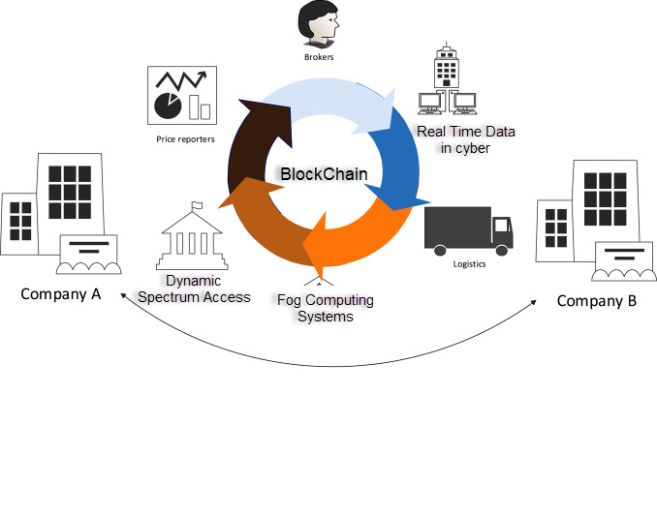
SYSTEM ARCHITECTURE

Slide 9
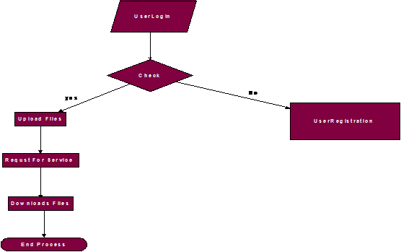
DATA FLOW DIAGRAM

Slide 10
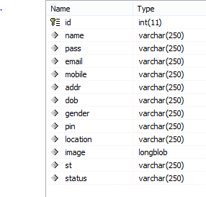
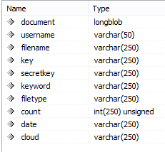
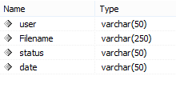
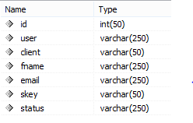
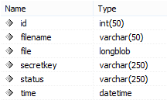
DATABASE DESIGN
Register Table Upload
Transaction
Request Attack

Slide 11
USE CASE DIAGRAM

Slide 12
CLASS DIAGRAM

Slide 13
ACTIVITY DIAGRAM

Slide 14
MODULES
Smart contracts
Cyber-physical systems
Cloud manufacturing
Blockchain technology

Slide 15
MODULES DESCRIPTION
Smart contracts:
SCs are permanently registered to the system as an application instance when deployed to a BC network.
A new application instance is created for each instance created from the same SC code. A SC code contains variables and functions.
In this application, when using SCs, it is discussed whether to store all jobs in a single SC or to create a new SC instance from the same SC code for each job. Both options will make the system work.
However, if we compare these two methods, it can be understood why it would be more appropriate to create a new SC instance for each job.
Cyber-physical systems:
TECHNOLOGICAL developments in manufacturing systems have changed the competitive factors in the sector.
Before 1970s, cost, which is one of these factors, one the most important factor, whereas quality gained importance after the 70s.
By 1990s, service and environmental factors gained importance and in the 21st century, information became the most important factor.
The information is the foundation of the 4th industrial revolution, namely, Industry 4.0.
The term Industry 4.0 collectively refers to a wide range of current concepts, including cyber-physical systems (CPS), internet of things (IoT), simulation, cloud computing, big data and advanced analysis techniques, service-oriented technologies, virtualisation and so on.

Slide 16
Cloud manufacturing:
Combining recently emerged technologies with advanced manufacturing models and information technologies, Cloud Manufacturing is a new manufacturing paradigm that meets the needs of manufacturing systems.
A number of significant researchers have been made to develop cloud manufacturing technologies, design the system architectures, and define cloud manufacturing and key characteristics.
Cloud manufacturing is based on cloud computing. Cloud computing highlights two features: ease of access and shared use of resources.
Cloud manufacturing, with these two feature of cloud computing, increases customers’ accessibility to manufacturing resources and capabilities through the Internet.
Blockchain technology:
These features of cloud manufacturing make it inefficient in scalability, interoperability, reliability, security, data confidentiality, efficiency, continuity and flexibility.
It is possible to use blockchain (BC) technology to solve many of these problems.
BC technology offers an innovative approach to decentralized and fully distributed mechanism in industries and businesses.
The BC technology basically can be considered as an immutable distributed ledger.
BC is a technology that comes to the fore with guaranteeing the reliability of the data it stores. The BC technology has the following powerful characteristic.

Slide 17
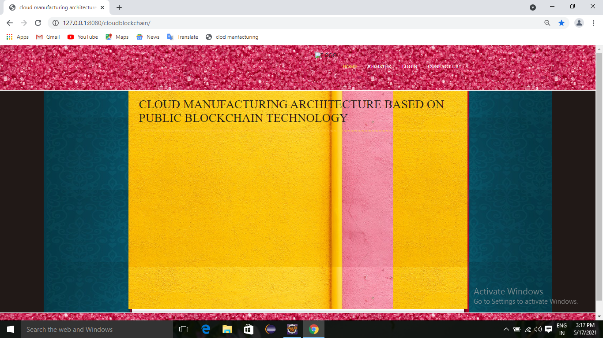
SCREENSHOTS
HOME PAGE

Slide 18
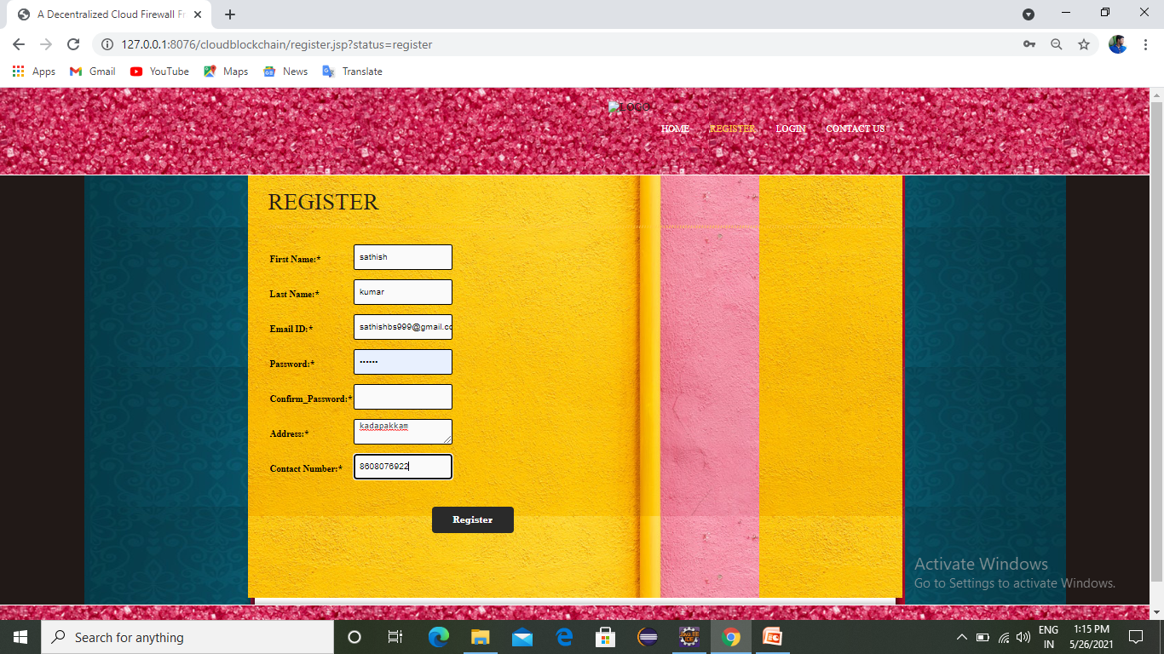
REGISTER PAGE

Slide 19
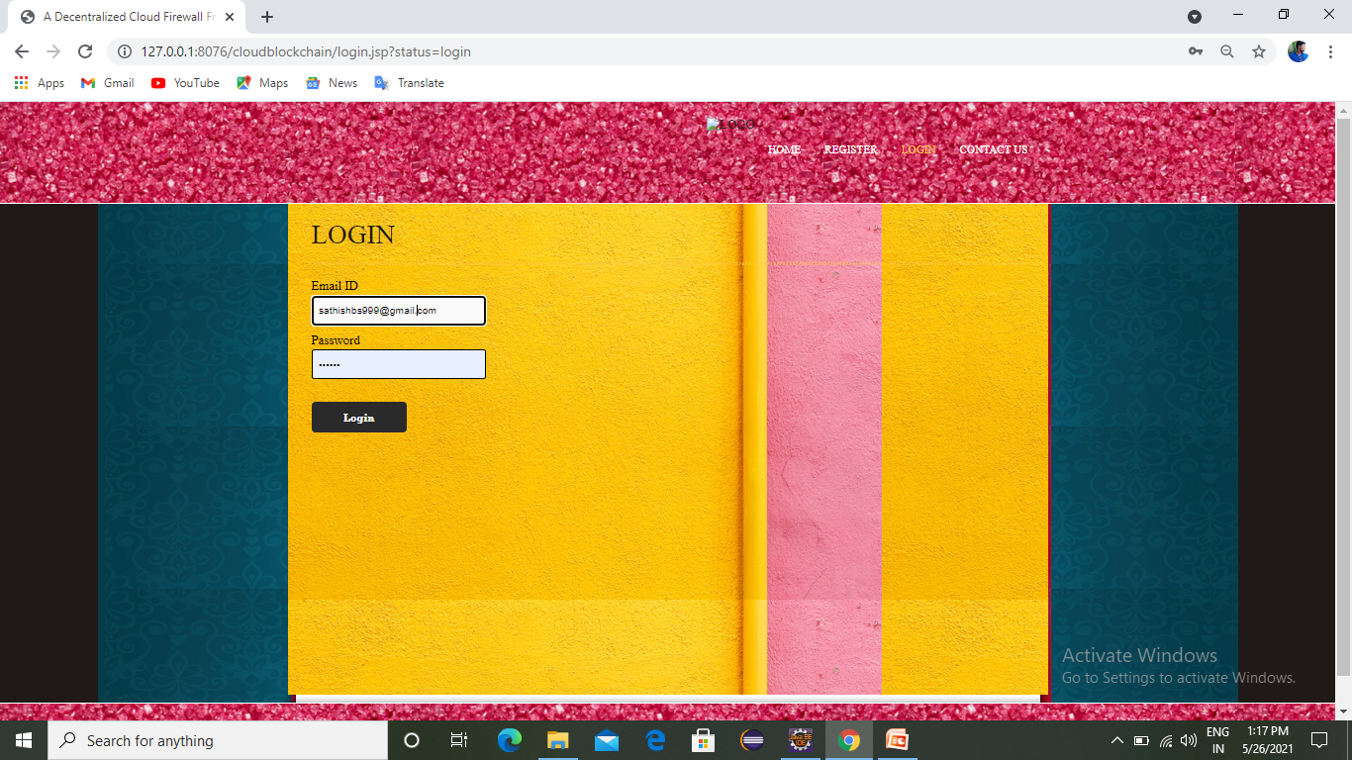
LOGIN PAGE

Slide 20
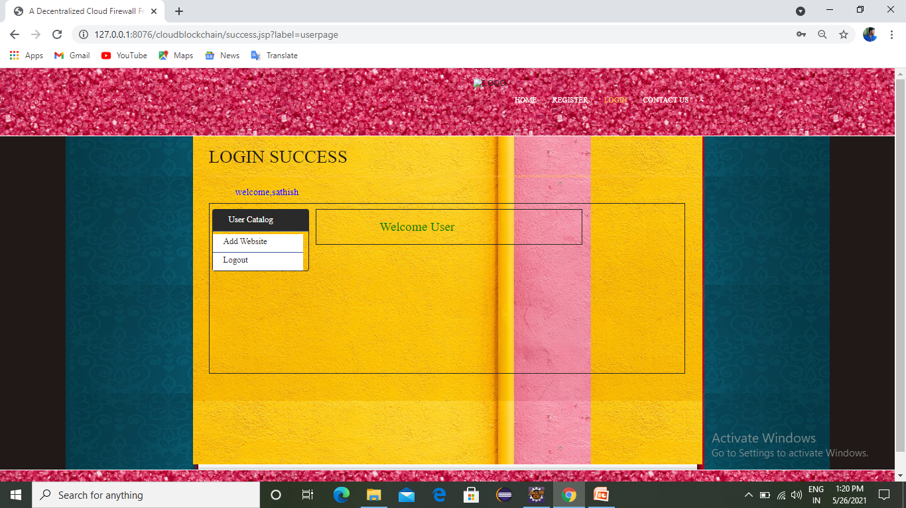
ADD WEBSITE

Slide 21
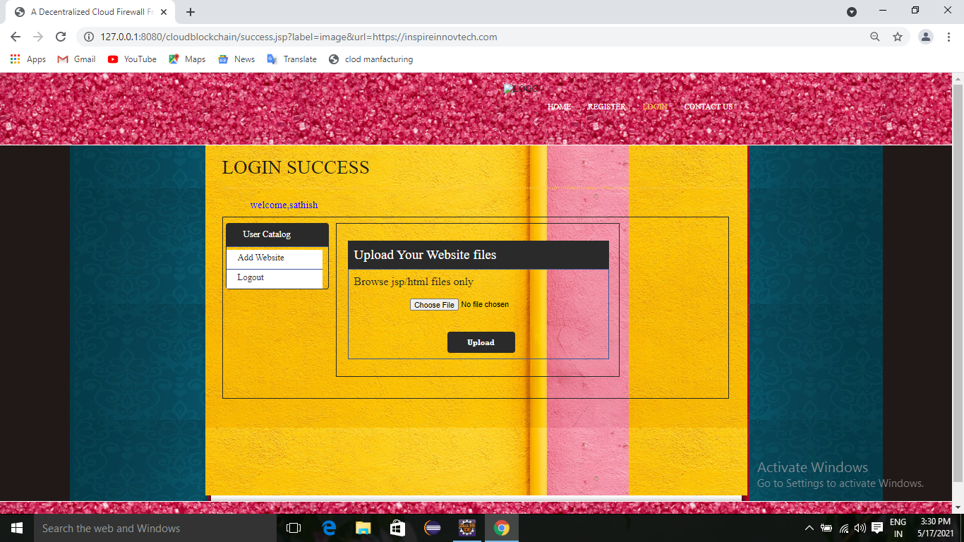
FILE UPLOAD

Slide 22

ADMIN LOGIN

Slide 23
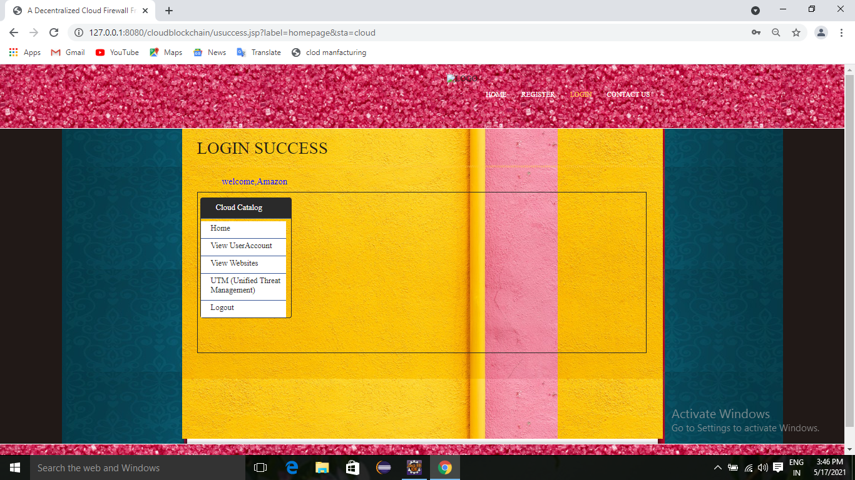
LOGIN SUCCESS

Slide 24
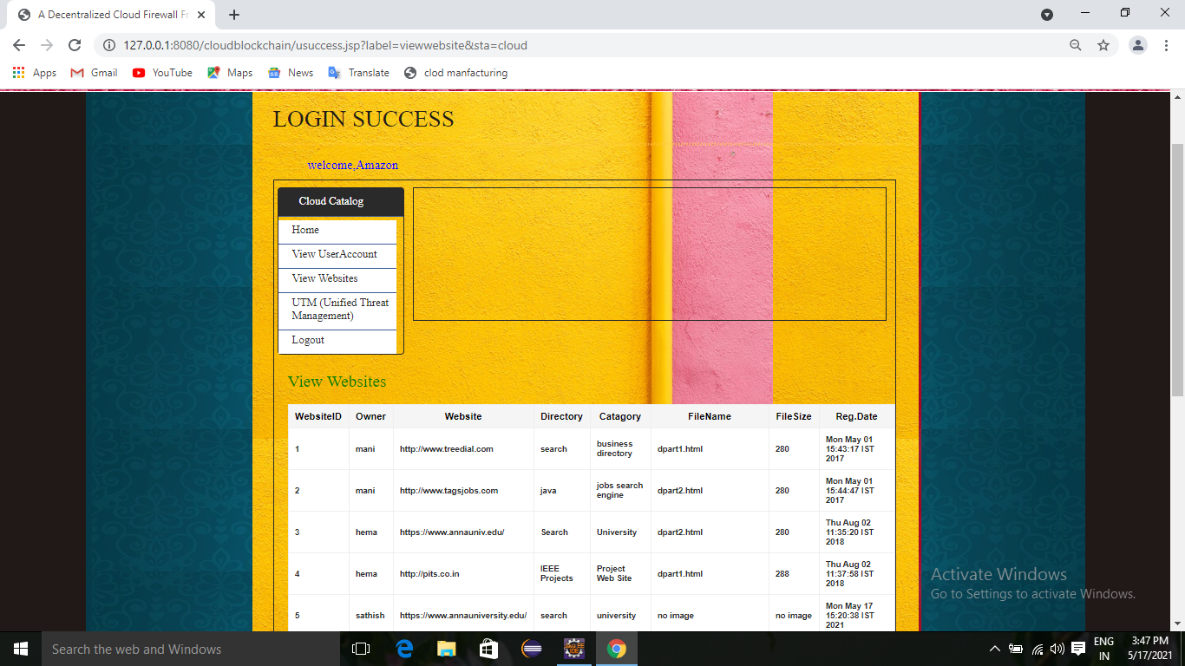
VIEW WEBSITES

Slide 25
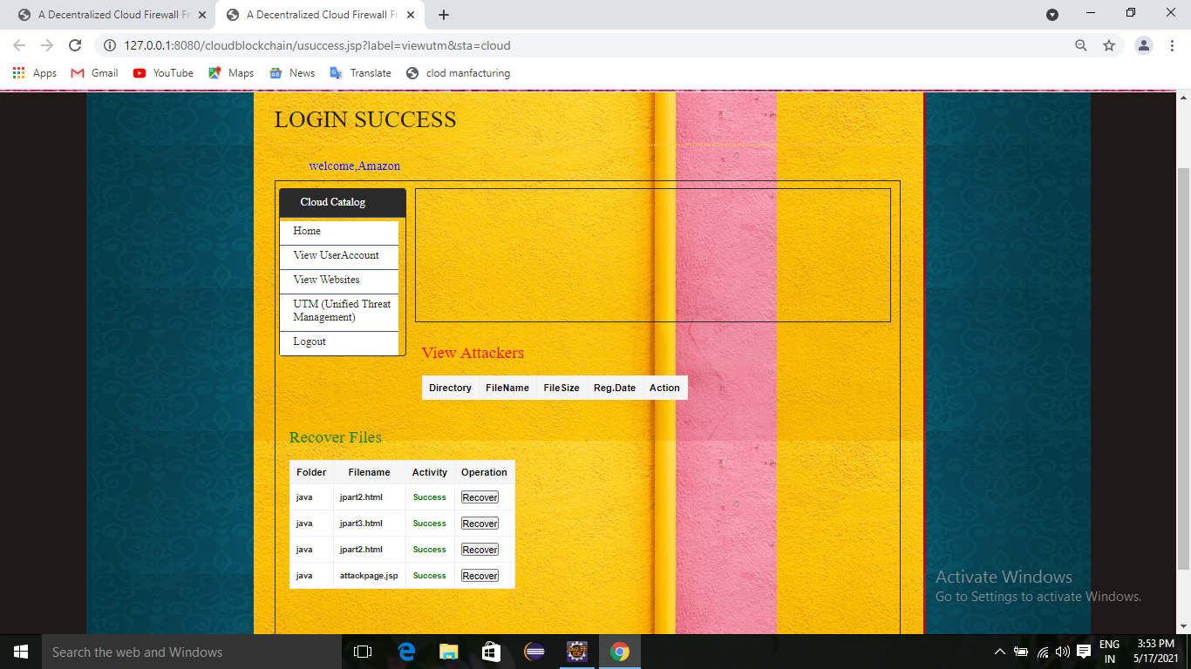
VIEW ATTACKERS

Slide 26
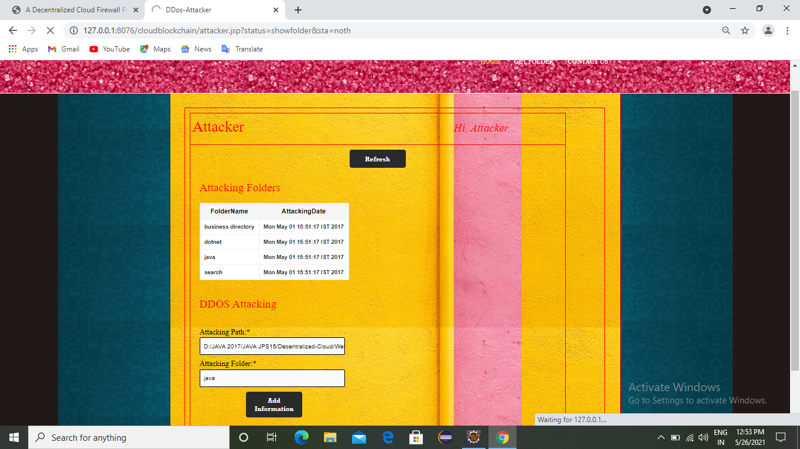
ATTACKING FOLDER

Slide 27
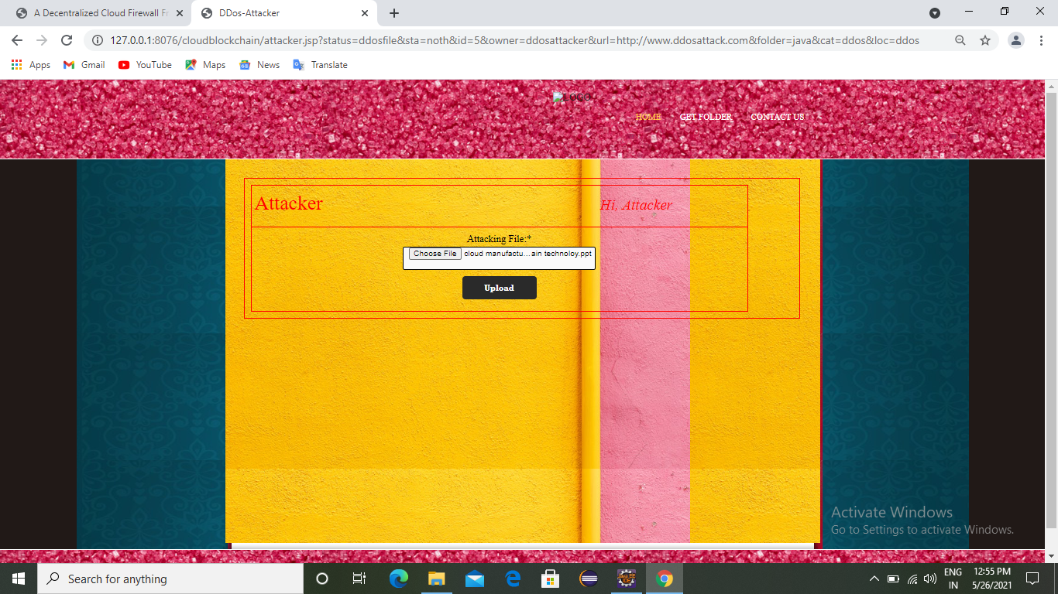
ATTACK FILE UPLOAD

Slide 28
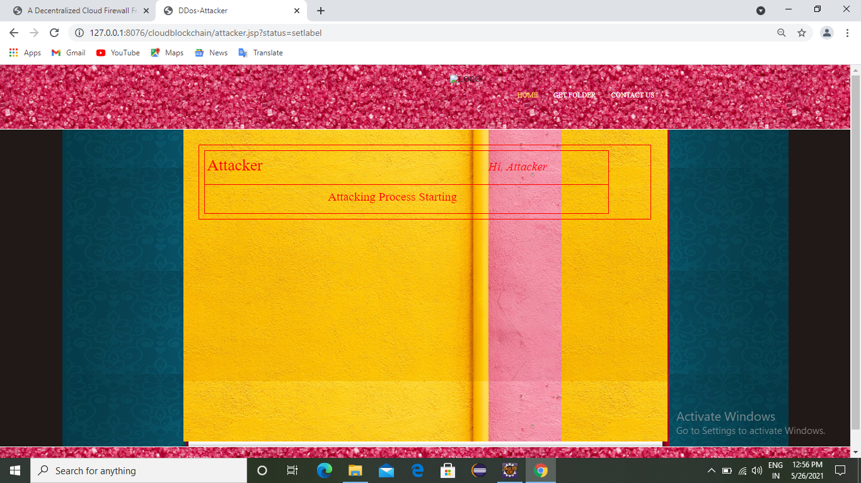
ATTACKING PROCESS

Slide 29
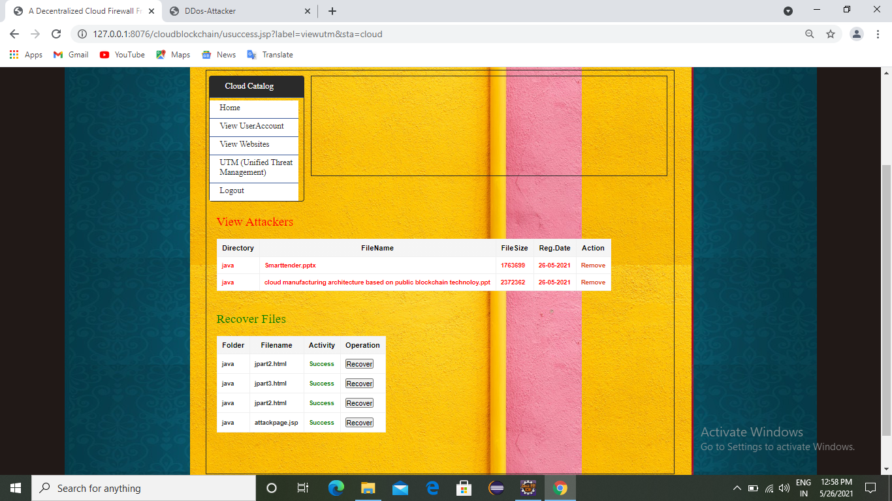
RECOVER FILES

Slide 30
CONCLUSION
With the capabilities of cloud manufacturing, resource owners and resource-seeking users can easily share resources through platforms.
However, the reliability of the platforms is seen as a question mark for the users. In this study, a BC based application is introduced for users to make agreements among themselves without the need of any third party.
The originality of this study is that the agreements are realized through the Ethereum network, which is a public BC network and supports SC.
However, the application is designed in a hybrid structure. Thanks to the hybrid structure, users pay only for agreements that need to be secured.
If the application was run in a completely public structure, all information would have to be stored on the public network, which would incur a serious cost. Apart from all this, in private networks, the fact that the network is controlled by a person or organization raises serious questions for users.
In addition, the server infrastructure must be provided by a party for private networks. For these reasons, a hybrid structure was preferred. With this model, users will be able to make manufacturing agreements between each other and make their payments without any intermediaries.

Slide 31
FUTURE ENHANCEMENT
In this study, the use of BC technology in cloud manufacturing is attempted to be explained with an example application and it is aimed to shed light on the future studies.
For future work, designed SCs may be developed and other services, such as machining as a service, will be directly integrated into the system.

